Slide 1
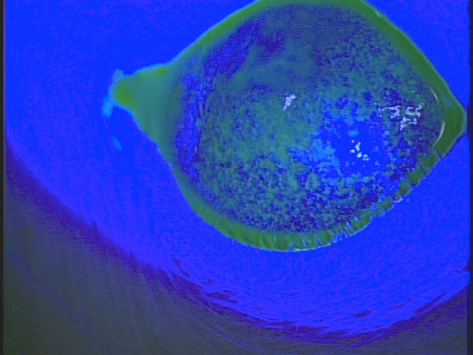
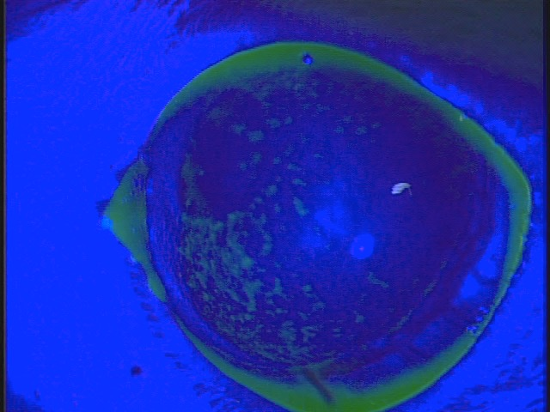
Day 2
Fluorescein staining
Saline group
H₂ group

